Slide 1
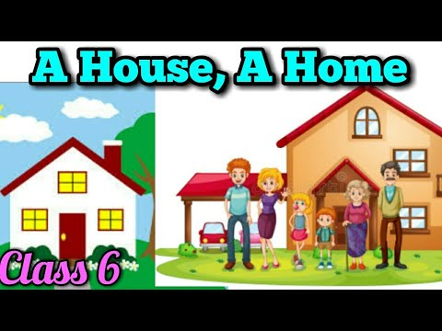

Slide 2
Introduction
In this poem the poet has explained the difference between a house and a home. He discusses the role that family members play in a home.

Slide 4
What is a house ?
It is a building made of brick, stone and hard wood. There are some glass windows and perhaps a yard also. There are eaves and chimneys and tiled floors. There are many doors with plastered walls and roof.

Slide 6
What is a home ?
It is the place where a loving family lives. They work for one another. A family may have brothers, sisters, fathers and mothers. The unselfish acts and kindly sharing, showing your concern each other make it a family.

Slide 7
Summary
The poet has tried to define and differentiate between a house and a home. He says that a house is made of bricks, stone and hardwood. It also has fine paints, chimney, window glass, doors, corridors, roof and tile floors. A home is another name for loving family members who take care of each other and work selflessly for one another. Brothers-sisters, fathers and mothers together make a home. It is their unselfish acts of kindness and sharing towards one another that makes a house a home.

Slide 8
Words Meaning
Yard: garden or corridors outside the house
Eaves: the part of the roof that hangs out over the walls to provide shade , elevations of the roof
Stucco: fine paint used for wall surface
Chimneys: smokestack, a pipe which takes smoke or combustion gases up from the fire.

Slide 9
Words Meaning
Unselfish: without any selfish interest, selfless
Kindly: lovingly

Slide 10
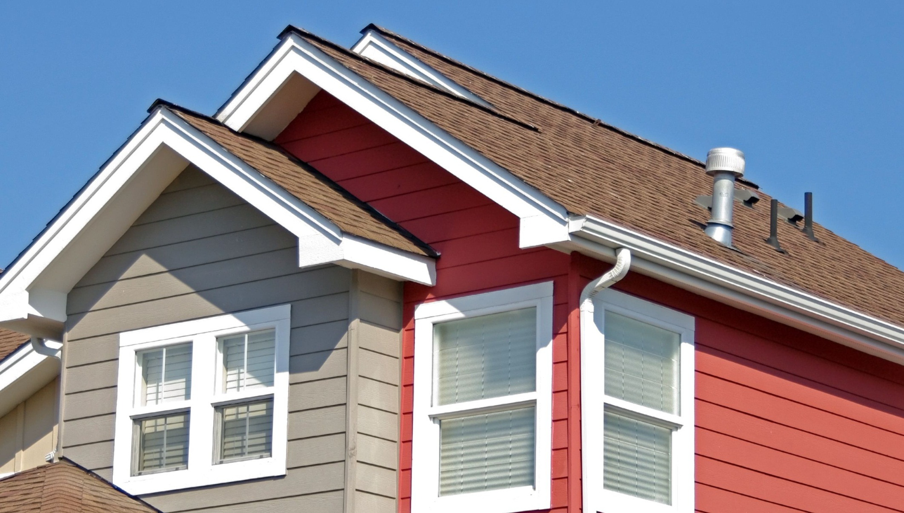
Eaves

Slide 11
Yard

Slide 12
Stuccoo

Slide 13
Chimney

Slide 14
Check Your Understanding
(i) A house is made of _______ (ii) It has _______ (iii) A home is made by _______ (iv) It has _______
(i) A house is made of brick, stone, cement, hard wood, window glass, and a yard.
(ii) It has eaves, chimneys, tile floors, stucco, roof, and lots of doors.
(iii) A home is made by family members.
(iv) It has unselfish acts, sharing, and caring for the loved ones.

Slide 15
Check Your Understanding
(i) My house is _______
(ii) The best thing about my home is _______
y house is very big. My house has bedrooms, bathrooms, kitchen, prayer room and dining room. I love my house so much.
(ii) The best thing about my home is homes offer security and feel affection for human life and it is one of the most important things.

